Slide 1
Analytics Project
Objective:
To streamline operational analysis for the College Management System by replacing manual data tracking with an automated, data-driven solution.
Tools & Methodology:
SQL (Microsoft SQL Server): Used for data cleaning, transformation, creating a star schema, and calculating key metrics (e.g., Average Grade, Total Credits, Instructor Workload).
Power BI: Used for data modeling, establishing relationships, and designing an interactive, user-friendly dashboard for visual analysis.

Slide 2
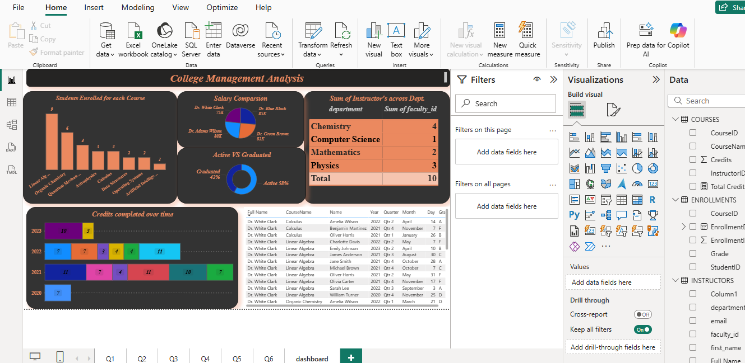
Dashboard Insights: Tracking Progress and Identifying Gaps.
Student Progress: Tracks cumulative credits completed by each student over time.
Course Performance: Identifies challenging courses (e.g., Organic Chemistry and Astrophysics) based on a high number of "F" grades.
At-Risk Students: Pinpoints students with low credit completion or poor grades for targeted support.
Instructor-Course Relationship: Shows which instructors teach which courses and how their students perform.

Slide 3
Summary
Outcomes & Conclusion:
Outcomes: The project successfully created an interactive dashboard that allows for the analysis of student, course, and instructor data. It effectively visualizes student progress over time and identifies key trends in academic performance.
Conclusion: The project is a robust, data-driven solution that provides a solid foundation for making informed decisions about student success and resource allocation.
Pros & Cons:
Pros: The dashboard is interactive and provides actionable insights, while the project follows a clear workflow from data preparation to final report.
Cons: The report is based on static files, so it can't provide real-time updates. It is also descriptive and lacks predictive analysis, which could be a valuable next step.

